Slide 1
Hardware Fundamentals
What is Hardware?
Hardware is the physical aspect of the computer, the thing we can touch.
A Computer is a Hardware and is an electronic device that manipulates information, or data using different input and output devices.

Slide 2
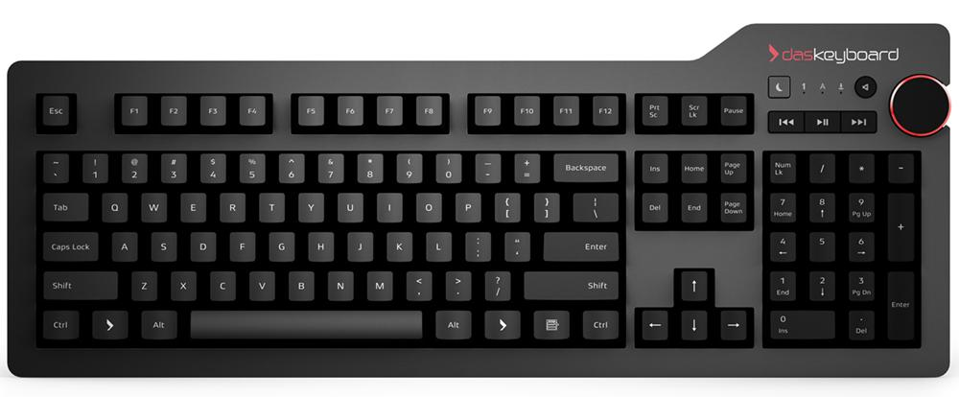
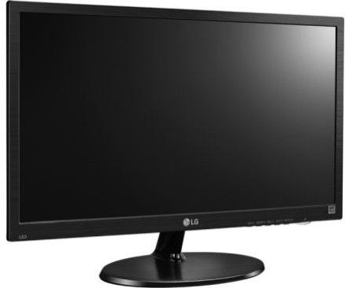

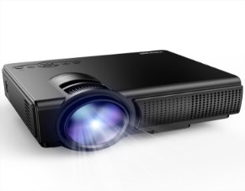
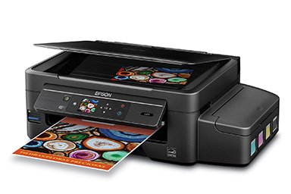
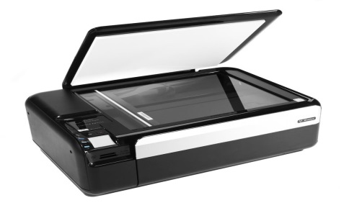
Computer
INPUT DEVICES
OUTPUT DEVICES
Keyboard
Monitor
Projector
Mouse
Scanner
Printer

Slide 3
Monitor
Monitor is an output devices which displays the information or output into pictorial form.
Monitors are connected to the computer via VGA,HDMI or other proprietary connectors through DB5 connector of motherboard.
Multiple technologies have been used for computer monitors like CRT,LCD and LED.

Slide 4
Cathode Ray Tube (CRT)
The cathode ray tube (CRT) is a vacuum tube that contain one or more electron guns and a phosphorescent screen, and is used to display images.
It modulates, accelerates, and deflects electron beams onto the screen to create the images.
Working of CRT

Slide 5
Disadvantages of CRT
The CRT's Gaussian beam profile produces images with softer edges that are not as sharp as an LCD at its native resolution. Imperfect focus and color registration also reduce sharpness. Generally sharper than LCDs at other than native resolutions.
Relatively bright but not as bright as LCDs. Not suitable for very brightly lit environments
All color CRTs produce annoying Moiré patterns. Many monitors include Moiré reduction, which normally doesn't eliminate the Moiré interference patterns entirely.
Some CRTs have a rounded spherical or cylindrical shape screen. Newer CRTs are flat.

Slide 6
Liquid Crystal Display (LCD)
A liquid-crystal display (LCD) is a flat-panel display that uses the light-modulating properties of liquid crystals.
Liquid crystals do not emit light directly, instead using a backlight or reflector to produce images in color or monochrome.
Working of LCD

Slide 7
Need of LED
1. Resolution Each panel has a fixed pixel resolution format determined at the time of manufacture that can not be changed. All other image resolutions require rescaling, which generally results in significant image degradation, particularly for fine text and graphics. For most applications should only be used at the native resolution of the panel. If you need fine text and graphics at more than one resolution do not get an LCD display.
2. Viewing Angle Limited viewing angle. Brightness, contrast, gamma and color mixtures vary with the viewing angle. Can lead to contrast and color reversal at large angles. Need to be viewed as close to straight ahead as possible.
3. Cost Considerably more expensive than comparable CRTs which forces the use of LED.

Slide 8
Light-Emitting Diode (LED)
A light-emitting diode (LED) is a two-lead semiconductor light source. It is a p-n junction diode that emits light when activated.
When a suitable current is applied to the leads,[electrons are able to recombine with electron holes within the device, releasing energy in the form of photons.
This effect is called electroluminescence, and the color of the light (corresponding to the energy of the photon) is determined by the energy bandgap of the semiconductor.
LEDs are typically small (less than 1 mm2) and integrated optical components may be used to shape the radiation pattern.
Appearing as practical electronic components in 1962, the earliest LEDs emitted low-intensity infrared light.
Infrared LEDs are still frequently used as transmitting elements in remote-control circuits, such as those in remote controls for a wide variety of consumer electronics. The first visible-light LEDs were of low intensity and limited to red. Modern LEDs are available across the visible, ultraviolet, and infrared wavelengths, with very high brightness.

Slide 9
Keyboard
In computing, a computer keyboard is a typewriter-style device which uses an arrangement of buttons or keys to act as a mechanical lever or electronic switch. Following the decline of punch cards and paper tape, interaction via teleprinter-style keyboards became the main input device for computers.
A keyboard typically has characters engraved or printed on the keys (buttons) and each press of a key typically corresponds to a single written symbol.
However, to produce some symbols requires pressing and holding several keys simultaneously or in sequence.
While most keyboard keys produce letters, numbers or signs (characters), other keys or simultaneous key presses can produce actions or execute computer commands.

Slide 10
Mechanism of keyboard

Slide 11
Mouse
A computer mouse is a hand-held pointing device that detects two-dimensional motion relative to a surface.
This motion is typically translated into the motion of a pointer on a display, which allows a smooth control of the graphical user interface.
The first public demonstration of a mouse controlling a computer system was in 1968.
Originally wired to a computer, modern mice are often cordless, relying on short-range radio communication with the connected system.
Mice originally used a ball rolling on a surface to detect motion, but modern mice often have optical sensors that have no moving parts.
In addition to moving a cursor, computer mice have one or more buttons to allow operations such as selection of a menu item on a display.
Mice often also feature other elements, such as touch surfaces and "wheels", which enable additional control and dimensional input.

Slide 12
Cabinet
Cabinet not only composed of CPU ,Hard disk but also various Hardware which are connected internally so that the computer works properly

Slide 13
Connectors
Connector (computer science), a pointer or link between two data structures
AC power plugs and sockets, devices that allow electrically operated equipment to be connected to the primary alternating current power supply in a building
RF connector, an electrical connector designed to work at radio frequencies in the multi-megahertz range
Circular connector
Cigarette lighter receptacle
Blind mate connector, a connector with self-aligning features
Board-to-board connector, for connecting printed circuit boards
Structural connector, in engineering

Slide 14
Motherboard

